Slide 1
INTRODUCTION TO MACHINE LEARNING
Introduction
Pablo Cañas
pablocanas97@gmail.com
NORTHIN SUMMER SCHOOL
Barcelona, July 2024

Slide 2
Course structure
Introduction: basic concepts, data preparation, linear regression
Fundamental Machine Learning concepts: Loss functions, optimization, cross-validation, overfitting
Supervised learning: naive bayes, k-NN, random forests, …
Unsupervised learning: clustering, dimensionality reduction.
Introduction to Deep Learning

Slide 3
What is Machine learning?
Machine Learning is the science of getting computers to learn and act like humans do, and improve their learning over time in autonomous fashion, by feeding them data and information in the form of observations and real-world interactions
Machine learning algorithms seek to provide knowledge to computers through data, observations, and interaction with the world. It is then used to make accurate predictions given new observations.
Machine learning is applied statistics!

Slide 4

Machine Learning/Deep Learning/ AI
Buzzwords, a lot of confusion. What are the differences?

Slide 5
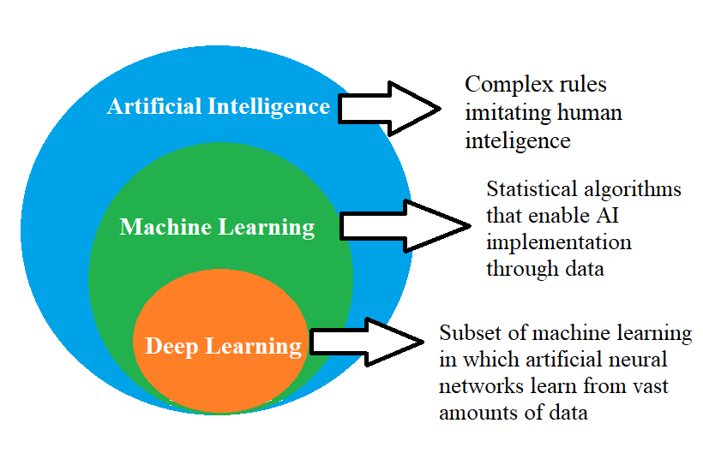
Machine Learning/Deep Learning/ AI
Buzzwords, a lot of confusion. What are the differences?

Slide 6
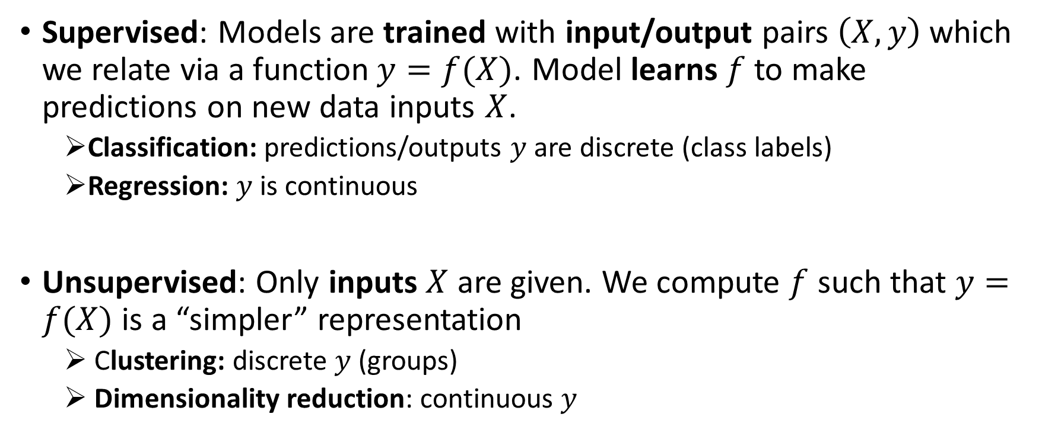
Machine learning algorithms

Slide 7
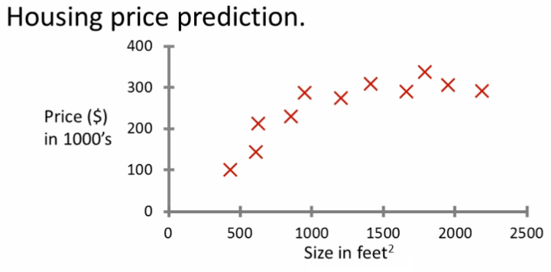
Supervised Learning: Regression
Predict continuous valued output. Ex: Housing price prediction.
Source: Coursera

Slide 8
Supervised Learning: Regression
Predict continuous valued output. Ex: Housing price prediction.
Linear regression model, predict price
Source: Coursera

Slide 9
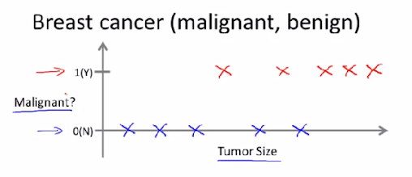
Supervised Learning: Classification
Predict discrete valued output. Ex: Breast cancer diagnose.

Slide 10
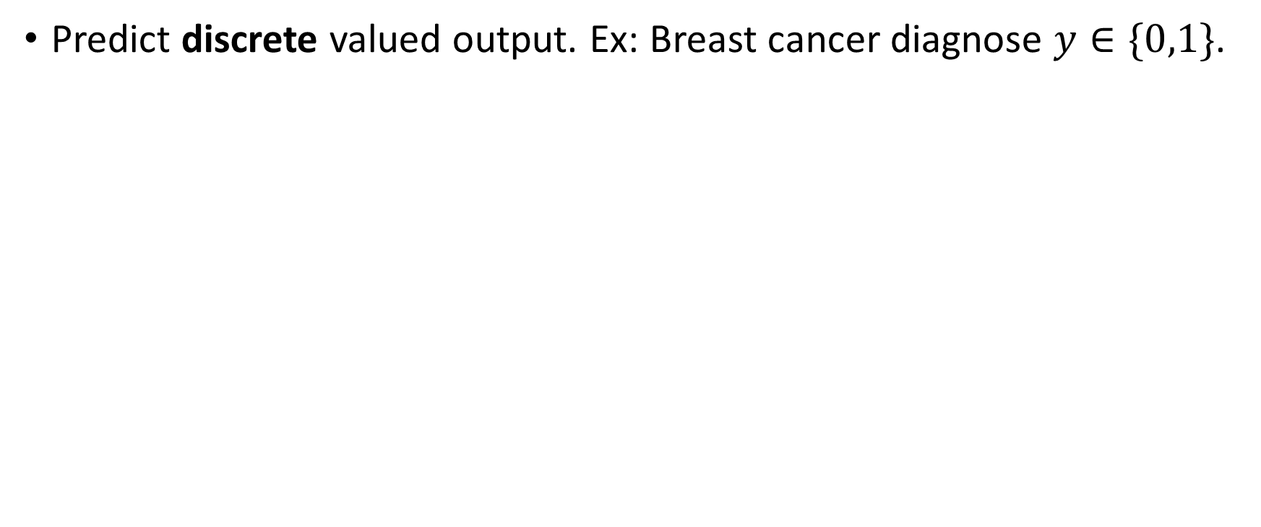
Supervised Learning: Classification
Logistic regression model, predict class probabilities

Slide 11
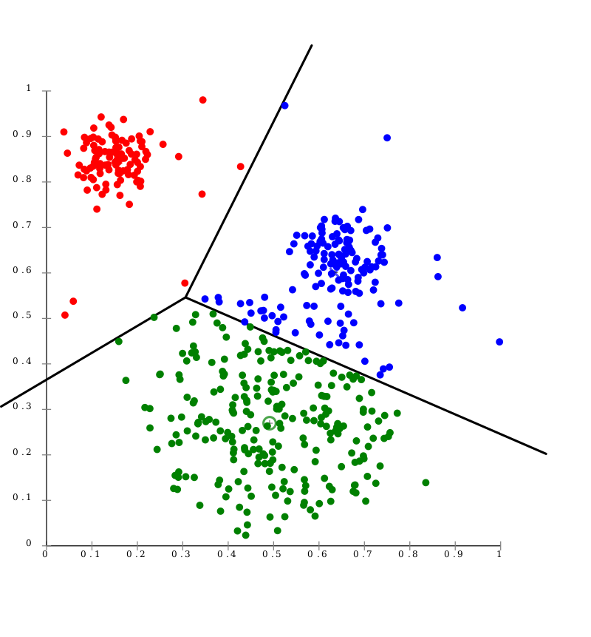
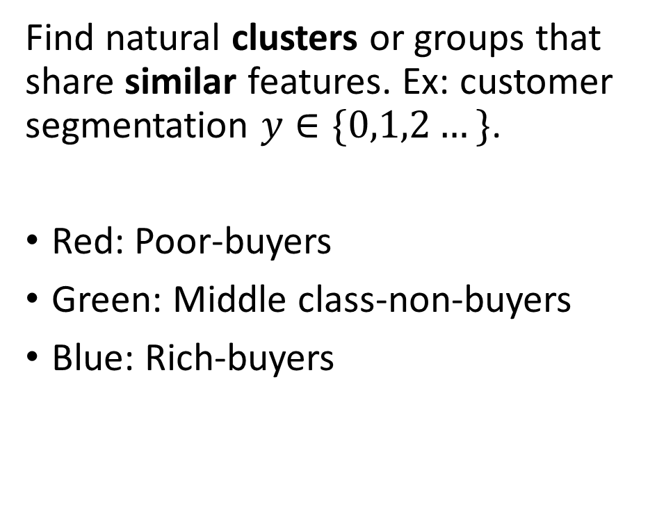
Unsupervised Learning: Clustering
Customer segments
Money spent by the customer
Income customer

Slide 12
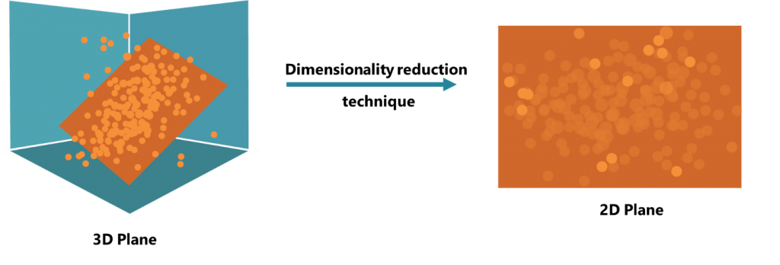

Unsupervised Learning: Dimension reduction
Reduce number of features, while keeping the maximum information
Reduce the complexity of the problem!

Slide 13
Quiz: Supervised/Unsupervised
Imagine a Telecomm company wants to automatically detect outages or failures in the network by identifying when there is a drop or spike in the network traffic.
Should we use a Supervised or Unsupervised algorithm?

Slide 14
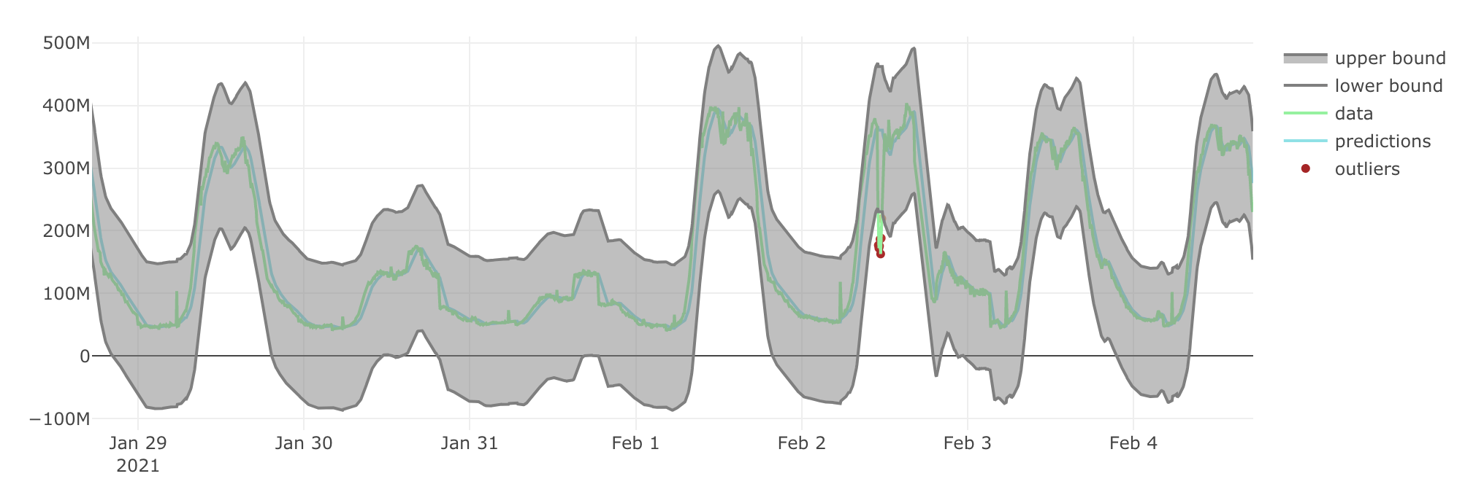
Quiz: Supervised/Unsupervised
Imagine a Telecomm company wants to automatically detect outages or failures in the network by identifying when there is a drop or spike in the network traffic.

Slide 15
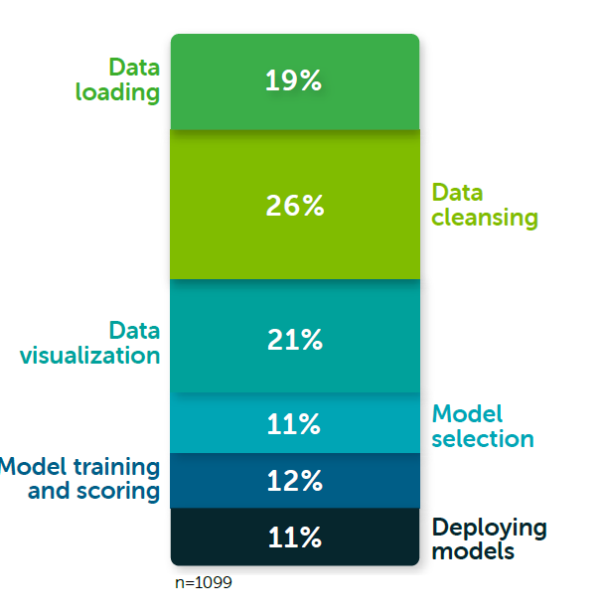

Data preparation
Data is the oil of machine learning
Prepare and analyse the data before applying machine learning!
66% Data preparation
Source: Anaconda
Source: Memegenerator

Slide 16
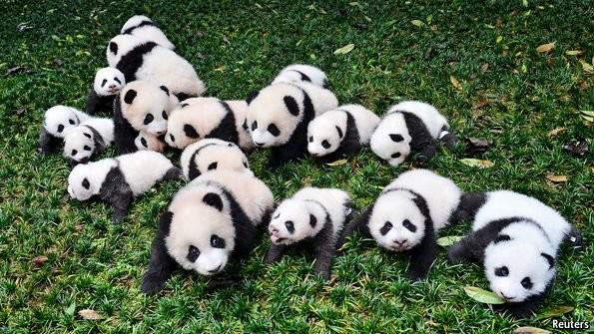
Data preparation with Python: Pandas
Pandas is a fast, powerful, flexible and easy to use data analysis and manipulation tool, built on top of Python
Source: Reuters

Slide 17
Python working environment
Option 1: Local Python installation (Anaconda + JupyterLab) - Or VS Code Jupyter extension
Option 2: JupyterLab in the cloud
Libraries for Machine Learning/Data Science: Pandas, NumPy, Scipy, Matplotlib

Slide 18
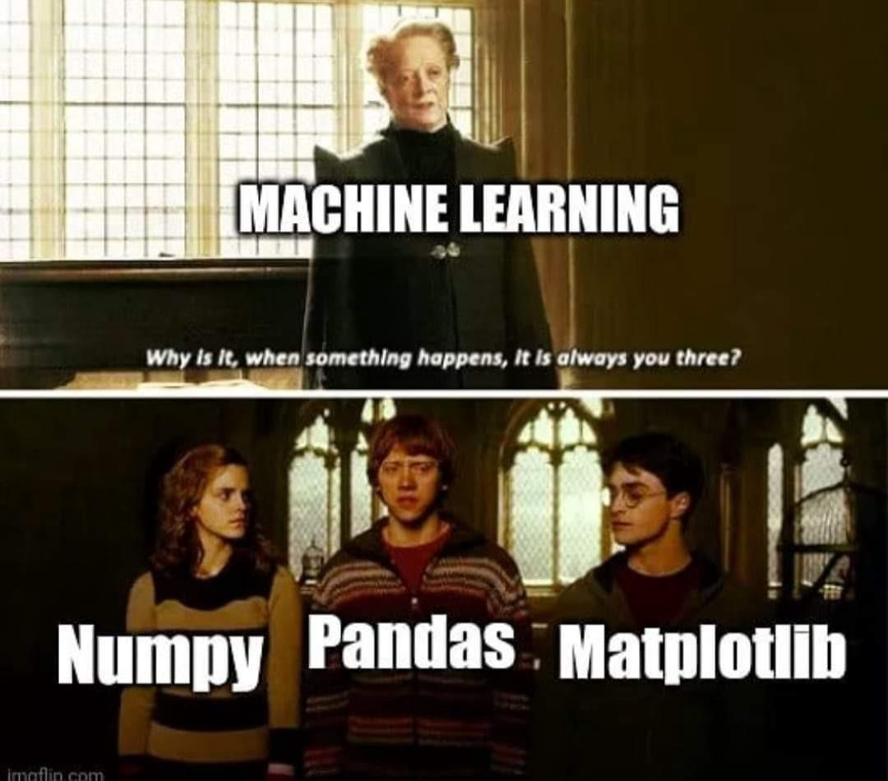
Python working environment
Option 1: Local Python installation (Anaconda + JupyterLab)
Option 2: JupyterLab in the cloud
Libraries for Machine Learning/Data Science: Pandas, NumPy, Scipy, Matplotlib
Source: Imgflip

Slide 19
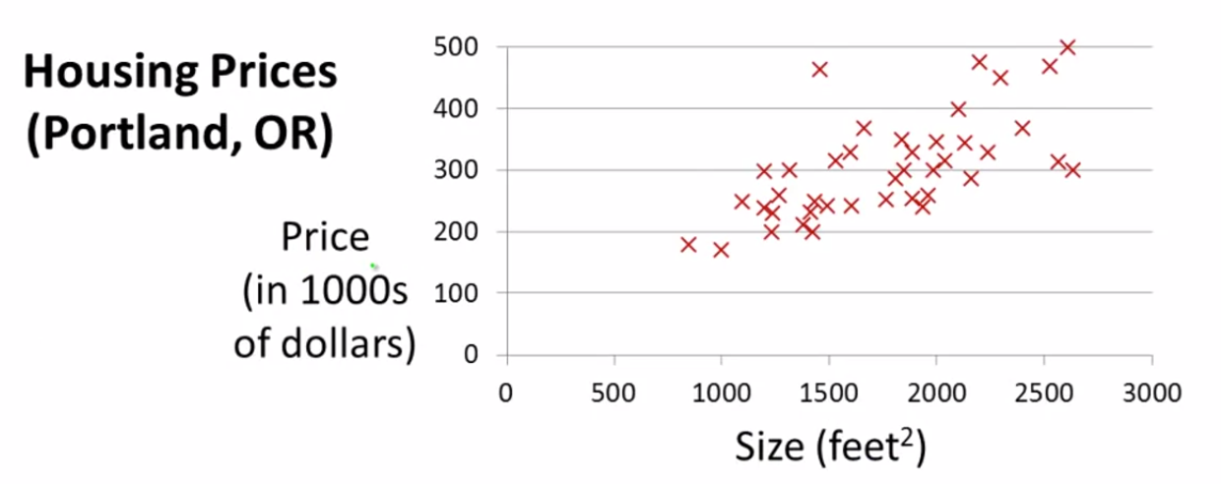
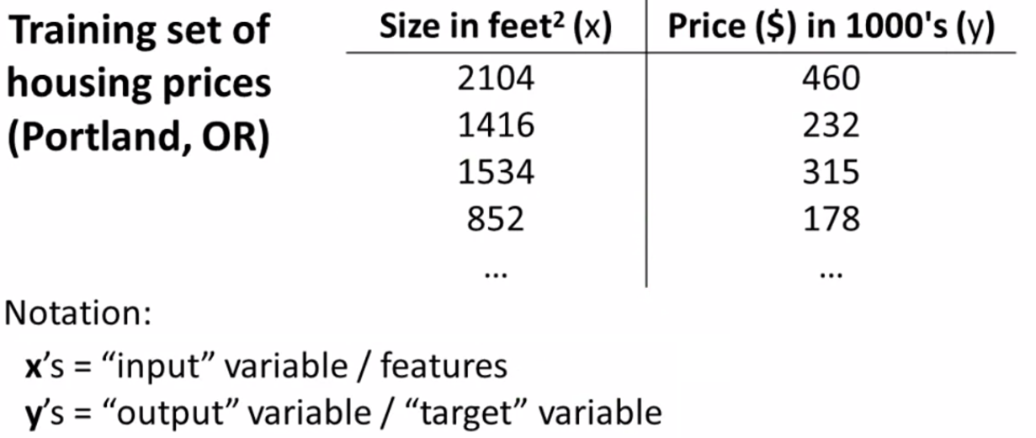
Linear regression: overview
Predict continuous-valued output
Example: given the size of a house, predict its price
Source: Coursera
Source: Coursera

Slide 20
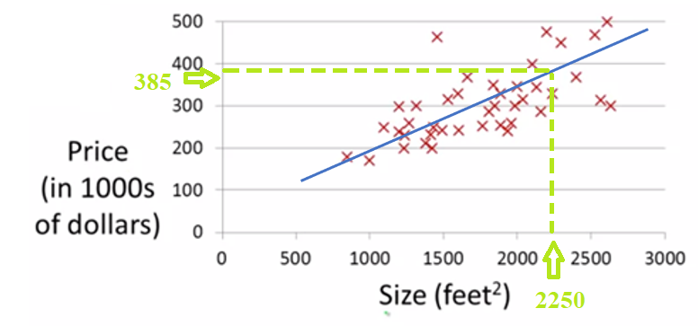

Linear regression: overview
Predict continuous-valued output
Example: given the size of a house, predict its price
Source: Coursera

Slide 21
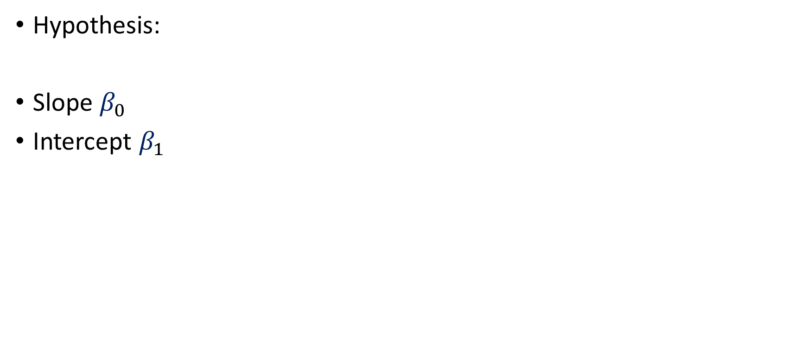
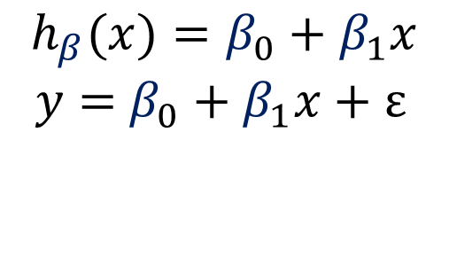
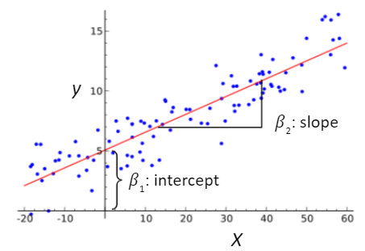
Linear regression: parameter interpretation

Slide 22
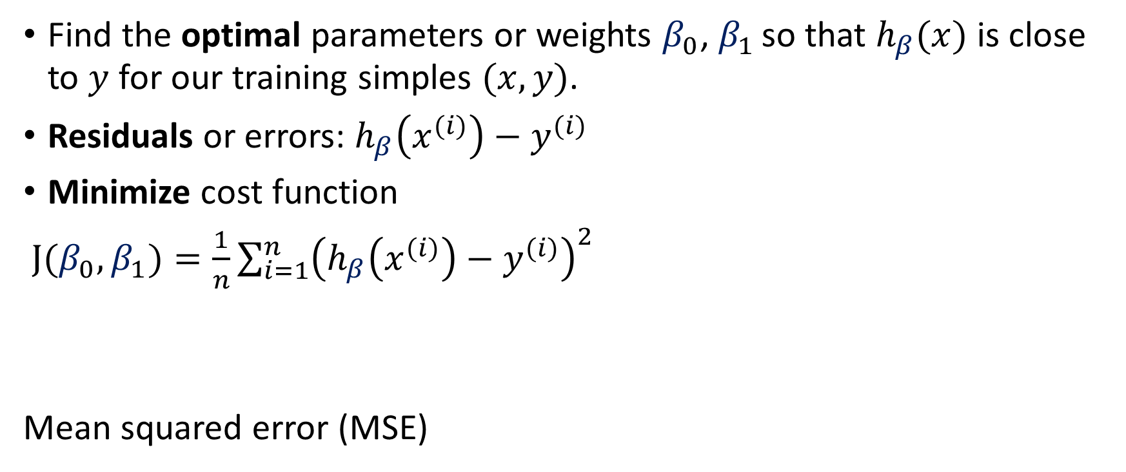
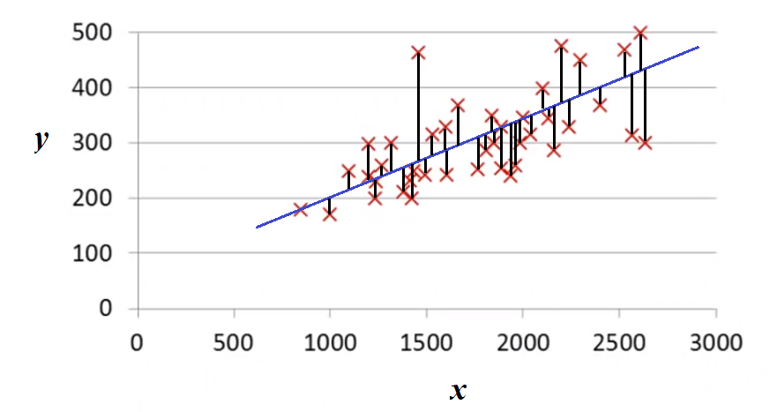
Linear regression: cost function

